Slide 1

Participant number: (Total n=60)

Slide 2
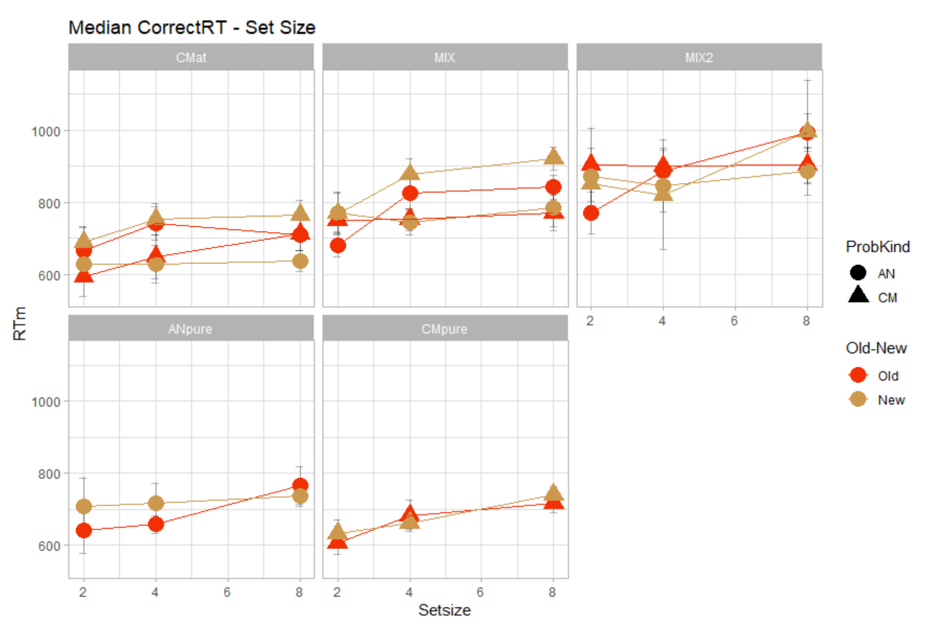
Median correct RT

Slide 3
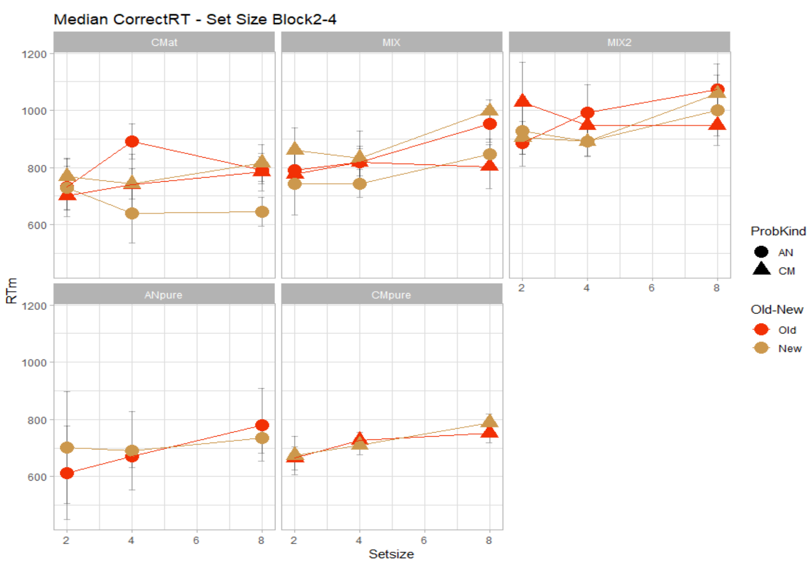
Median correct RT

Slide 4
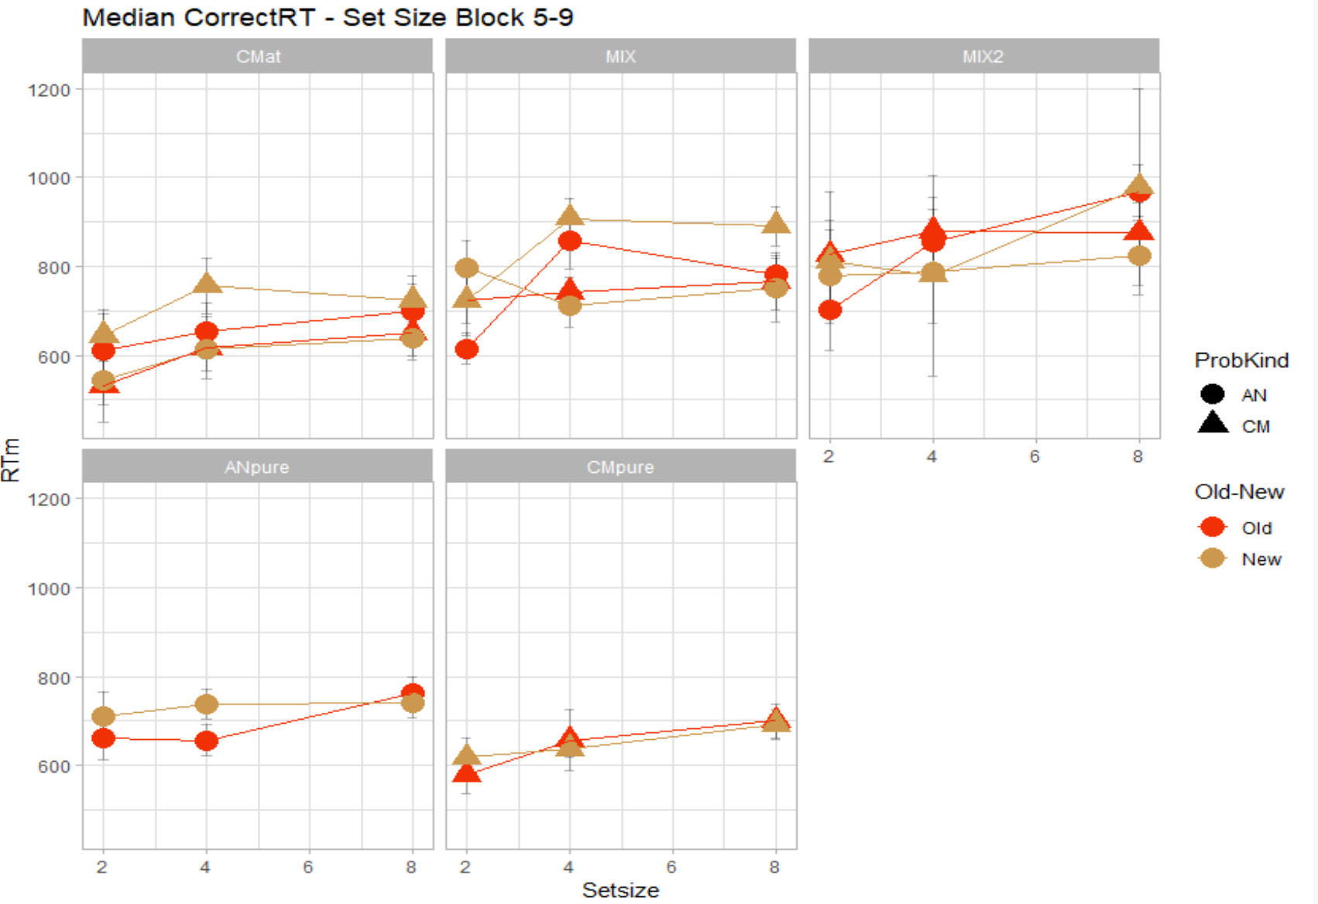
Median correct RT

Slide 5
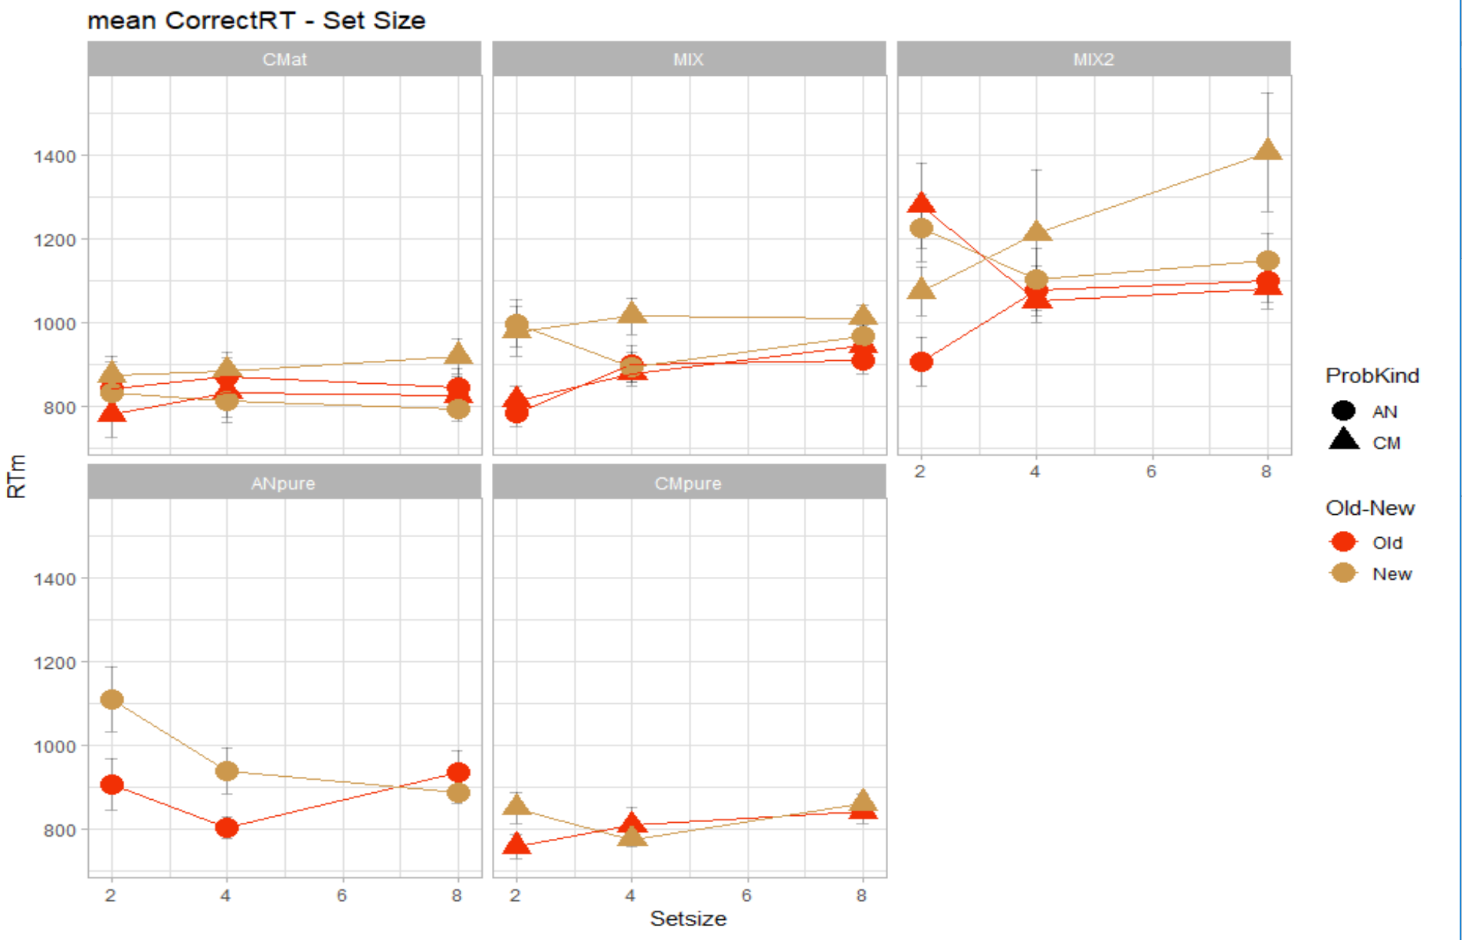
Mean correct RT

Slide 6
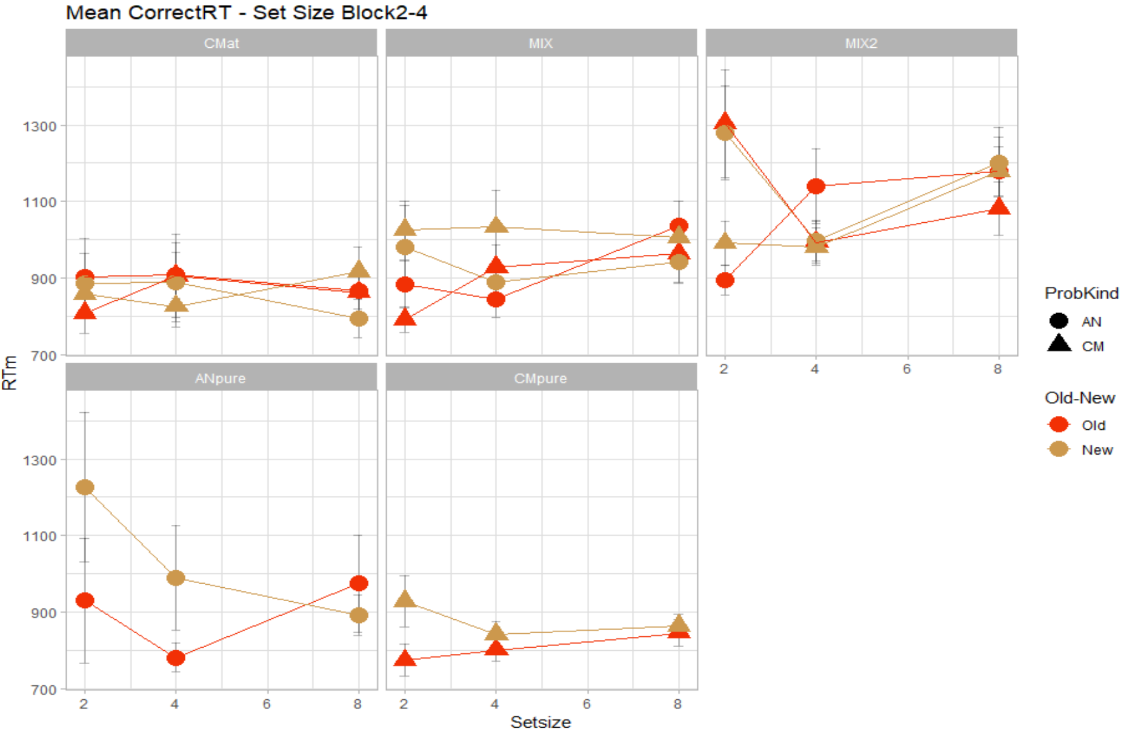
Mean correct RT

Slide 7
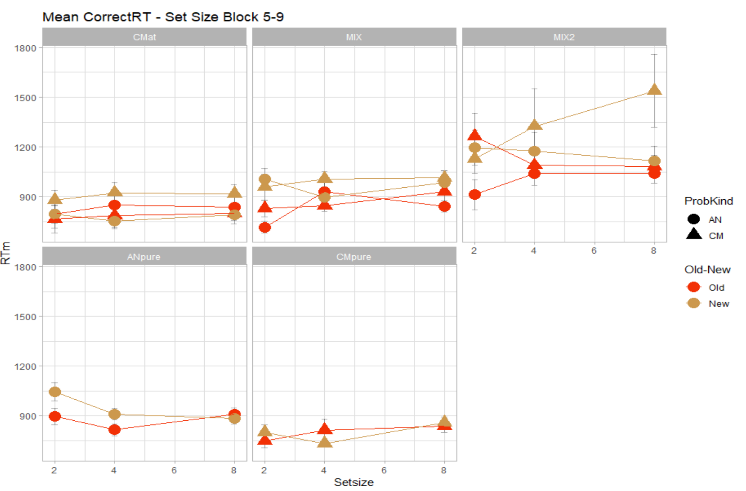
Mean correct RT

Slide 8
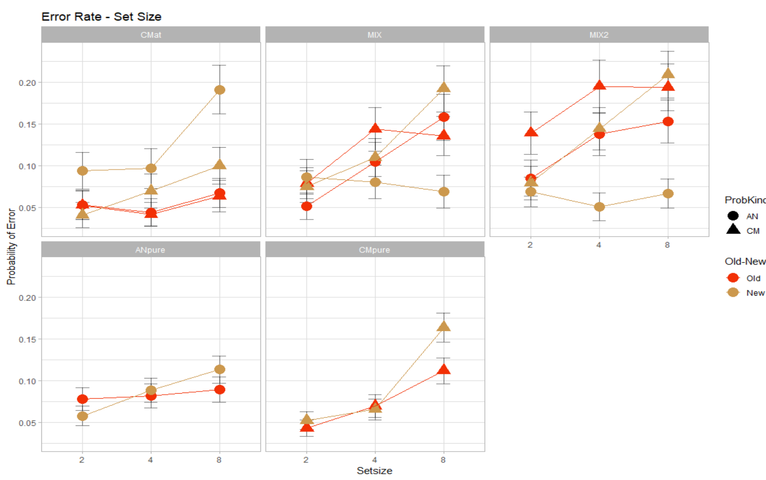
Error Rate

Slide 9
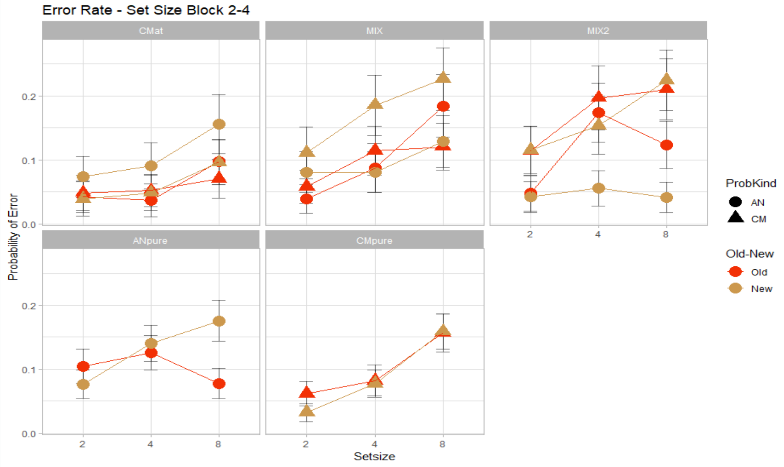
Error Rate

Slide 10
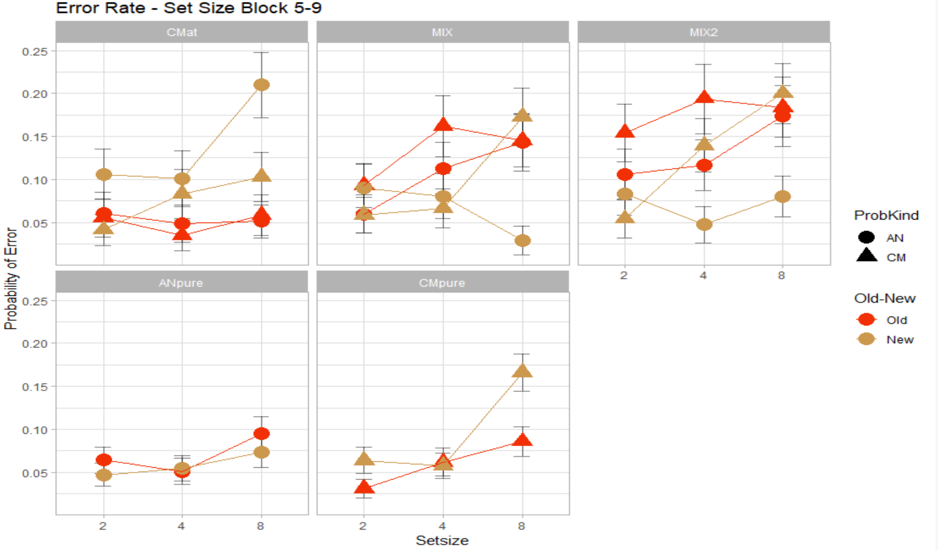
Error Rate

